Slide 1
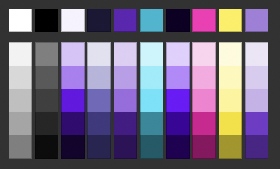





Project
A - based
product-ready distribution
The distributed operating system targeting IoT devices big and small
Yocto Project Summit, 2022.05

Slide 2
OK, but who is that fella?
02

Slide 3
OK, but who is that fella?
Andrei Gherzan
Huawei Open Source Technology Center
Principal Open Source Architect
02

Slide 4

















DELIVERING A UNIQUE USER EXPERIENCE ACROSS DIFFERENT CONSUMER DEVICES AND SCENARIOS
In a fully-connected world vision, consumer device fragmentation
is impacting on our daily life...
Think about how many devices you use on a regular basis that
accompany your day and how many actions you have to do to achieve
a good user experience from each of them.
Building together a fully-connected all-scenario intelligent ecosystem
03

Slide 5
WHY WE TALK ABOUT FRAGMENTATION IN THE IoT MARKET?
Fragmented and
isolated consumer
devices market
Technology silos
Small developers
ecosystem
Lack in content
creation portability,
stability SDK
and non unified
tools
Communication
between devices is
enabled by discrete
apps that are
connected to the
Cloud to share and
sync data, with lack in
performances, speed
along with security
and privacy issues
Building together a fully-connected all-scenario intelligent ecosystem
04

Slide 6
IoT NEEDS COMMON STANDARDS TO LIVE UP TO ITS PROMISE OF EMPOWERING CONSUMERS’ DAILY LIFE
One single
Cohesive application
Interoperability
between devices
One broad range
ecosystem
Write once, deploy on
different devices
In-house secured data
sync and sharing
Building together a fully-connected all-scenario intelligent ecosystem
05

Slide 7












WHY OPEN SOURCE
UBIQUITOUS
COLLABORATIVE
OPEN
Open source technology baseline, is the only way to achieve real co-operability, interoperability and communication
between different devices because they are natively talking the same language.
THE INFLUENCE ON REQUIREMENTS, ROADMAP AND FEATURES IS THE KEY!
Building together a fully-connected all-scenario intelligent ecosystem
06

Slide 8

THE MISSION IS TO ACHIEVE THE GOAL
OF AVOIDING TECHNOLOGY SILOS
THROUGH THE PATH OF OPEN SOURCE.
THAT MEANS PROVIDING EVERY DEVICE
MAKER WITH THE SAME TECHNOLOGY
BASELINE, IN AN OPEN, TRUSTED,
TRANSPARENT, COLLABORATIVE WAY.
Building together a fully-connected all-scenario intelligent ecosystem
07

Slide 9
WE ACHIEVE THE GOAL THROUGH THE PATH OF REAL OPEN SOURCE
Community
Reuse of existing open source software.
Welcome developers across all verticals. The
role of foundations like Eclipse Foundation
and OpenAtom to grant neutrality and open
governance
Implementation
Technology
End to end implementation
thanks to a dynamic open
ecosystem
A distributed virtual device
concept to provide all the
device makers with the same
technology baseline
OPEN SOURCE
Applications
Hardware
Distributed app and data
management
Diffused app ecosystem
Multidevice app development
Technology freedom and
inclusivity. One OS for three
different size and category
devices
Building together a fully-connected all-scenario intelligent ecosystem
08

Slide 10
WE ACHIEVE THE GOAL THROUGH
ONIRO HAS A LAYERED ARCHITECTURE BUILT AROUND THE
YOCTO PROJECT AND BITBAKE BUILD SYSTEM.
THE YOCTO PROJECT IS VERY POPULAR IN THE EMBEDDED LINUX
COMMUNITY AND PROVIDES AN EXCELLENT PLATFORM FOR DEVELOPING A
HIGHLY-CUSTOMIZABLE, CROSS-KERNEL OPERATING SYSTEM.
FROM BOTTOM TO TOP, ONIRO CONSISTS OF THE KERNEL LAYER,
SYSTEM SERVICES LAYER, FRAMEWORK LAYER, AND APPLICATION LAYER. IN
MULTI-DEVICE DEVELOPMENT, YOCTO PROVIDES THE CAPABILITIES TO TWEAK
LAYERS AND RECIPES TO REMOVE UNNECESSARY SUBSYSTEMS, FUNCTIONS, OR
MODULES AS REQUIRED.
Building together a fully-connected all-scenario intelligent ecosystem
09

Slide 11






THE ARCHITECTURE LAYERS
Application Layer
Framework Layer
When completed, it will host
the system and third-party
applications. Oniro
applications will be able to use
APIs to expose business logic
as abilities that may be utilized
inside other applications
It will provide an SDK to de-
velop Oniro appli-
cations in multiple languages
such as Java, C, C++ and JS
depending on the target device
class and its HW constraints
System Service
Layer
It will contain the bulk of the
differentiating features of Oniro. It will provide a
complete set of capabilities es-
sential for Oniro to
offer services for applications
through the Framework Layer
Kernel Layer
Oniro will support a
multi-kernel design design out
of the box so that appropriate
OS kernels can be selected for
devices with different resource
limitations

Slide 12

THE ARCHITECTURE LAYERS
meta-oniro: root layer
meta-openembedded
meta-clang
meta-zephyr, meta-freertos, meta-liteos
meta-riscv
meta-openharmony: openharmony components
meta-seco, meta-st, meta-av96, meta-intel, ...
Building together a fully-connected all-scenario intelligent ecosystem
11

Slide 13
ONIRO 22.12 “GOOFY” ROADMAP
Alpha (June 2022)
Beta (Sept 2022)
Feature Freeze
GA (December 2022)
LTS Toolchain
Yocto upstream sync
OpenHarmony upstream sync
LiteOS Kernel Linux 5.1x LTS Zephyr LTS
Runtime and
Tools
LTS Toolchain
Yocto upstream sync
OpenHarmony upstream sync
Security: runtime and configuration hardening Linux
Security: runtime and configuration hardening Zephyr
Runtime &
Tools
System OTA Linux
System OTA Zephyr
System OTA Linux
System OTA Zephyr
System OTA end-to-end including cloud backend
Backend runtime debuggers (gdb, gdbserver, kgdb…)
Backend runtime debuggers (gdb, gdbserver, kgdb…)
Building together a fully-connected all-scenario intelligent ecosystem
12

Slide 14
ONIRO 22.12 “GOOFY” ROADMAP
Alpha (June 2022)
Beta (Sept 2022)
Feature Freeze
GA (December 2022)
SECO SBC C61 – NXP i.MX8M Mini – Linux and Zephyr
SECO SBC B68 – Intel Atom – Linux and Zephyr
SECO C23 – Rockchip – Linux and Zephyr
SECO SBC C61 – NXP i.MX8M Mini – Linux and Zephyr
SECO SBC B68 – Intel Atom – Linux and Zephyr
SECO C23 – Rockchip – Linux and Zephyr
Reference
Hardware
Arduino Nano BLE – Zephyr
Rpi 3/4 – Linux
Udoo Key – RPI RP2040 & ESP32 – Linux and Zephyr
Arduino Nano BLE – Zephyr
Rpi 3/4 – Linux
Udoo Key – RPI RP2040 & ESP32 – Linux and Zephyr
OpenHarmony supported targets*
OpenHarmony supported targets*
QEMU for Intel, ARM, RISC-V – Linux, Zephyr, LiteOS
QEMU for Intel, ARM, RISC-V – Linux, Zephyr, LiteOS
*- pending IP clearance, no SLA, official support from OpenAtom
*- pending IP clearance, no SLA, official support from OpenAtom
Integration of performance and benchmarking
Integration of standard test toolkits
Integration of performance and benchmarking
Integration of standard test toolkits
Periodic report of functional and perf verification
Finalize device testing infrastructure and testing lab blueprint instructions
Finalize device testing infrastructure and testing lab blueprint instructions
Testing &
Infrastructure
Bring one additional testing lab online
Bring second additional testing lab online
Four independent testing labs online
ACTS decoupling from currently supported implementations
ACTS decoupling from currently supported implementations
Security/release tooling: report pending CVEs in all builds
Security/release tooling: vulnerability handling tool
Security/release tooling:
Report pending CVEs in all builds
Vulnerability handling tool
Report stable version updates (available upstream)
Oniro repositories restructuring
Building together a fully-connected all-scenario intelligent ecosystem
13

Slide 15
ONIRO 22.12 “GOOFY” ROADMAP
Alpha (June 2022)
Beta (Sept 2022)
Feature Freeze
GA (December 2022)
Gesture and Voice Input Midi Device – V1
Smart Home Assistant based on Mycroft – V1
Gesture and Voice Input Midi Device – V1
Smart Panel – V2 (CATS)
Transparent Gateway – V2
Smart Home Assistant based on Mycroft – V1
Jasmine selected BPs carry fwd – V2
Transparent Gateway – V2
Reference
Blueprints
Smart Panel – V2 (CATS)
Jasmine selected BPs carry fwd – V2
Selected BPs interactive cooperative use cases
Lock Yocto Project target release
Lock OpenChain /REUSE target spec
Lock OpenHarmony target release
Lock Matter target release
Lock LEDGE target release
Lock Yocto Project compatibility
Lock OpenChain /REUSE compatibility
Lock OpenHarmony compatibility
Lock Matter compatibility
Lock LEDGE compatibility
Standards &
Compilance
Intelligent Agency: Communication Plumbing
Intelligent Agency: Communication Plumbing
Intelligent Agency: Virtualization Layer
Intelligent Agency: Simple Cooperative Use Case
Intelligent Agency: Virtualization Layer
Autonomous
Agency
Intelligent Agency: Application Management Layer
Intelligent Agency: Intelligent Coordination Use Cases
Building together a fully-connected all-scenario intelligent ecosystem
14

Slide 16

LIFECYCLE AND RELEASE SCHEDULE
2020
2021
2022
2023
2024
2025
2026
^{1.0 JASMINE RELEASE}
(2021)
^{KERNEL UPGRADE}
Development
LTS y.1
LTS y.2
LTS y.3
^{TOOLCHAIN UPGRADE}
^{USER SPEC UPGRADE}
^{BSPS UPGRADE/OBSOLENCE}
^{2.0 GOOFY RELEASE}
(2022)
Development
LTS y.1
LTS y.2
LTS y.3
^{3.0 DAISY RELEASE}
(2023)
Development
LTS y.1
LTS y.2
LTS y.3
BUGS
CVEs
YEAR 1
All
All
YEAR 2
P1/P2
All Toolchain CVSS 9-10
YEAR 3
P1
CVSS 7-10
Toolchain CVSS 9-10
Building together a fully-connected all-scenario intelligent ecosystem
15

Slide 17
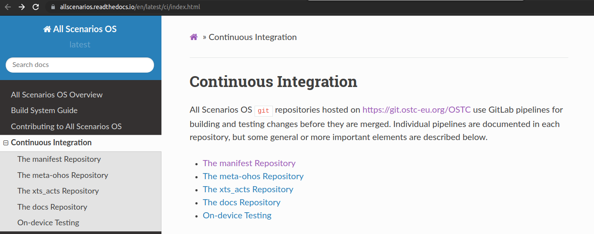
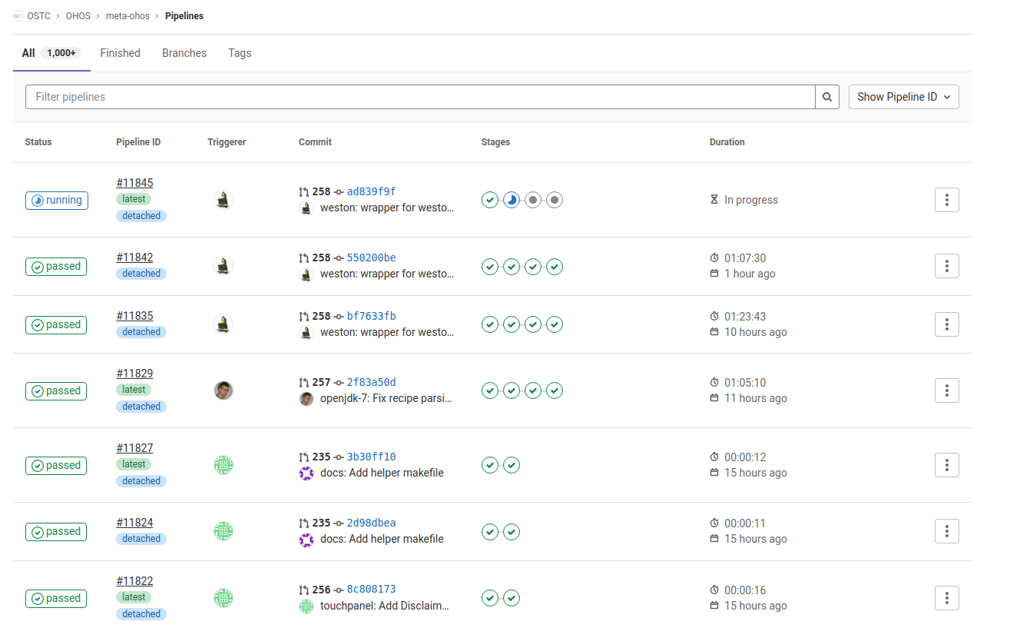
CONTINUOUS INTEGRATION AND DEPLOYMENT
gitlab runners for builds, with git-repo cache, bitbake sstate and download cache
strategic placement of jobs across repositories to ease maintenance
lava for smoke testing on hardware and in virtual environments
Scancode, Fossology, REUSE, Debian matcher for license compliance and SPDX SBOM
14 shared jobs for images officially supported
workspace --> assembles all repos via git repo
bitbake-workspace --> initialized bitbake build
build-linux, build-zephyr, build-freertos, build-liteos
build-docs
lava-test, lava-report
ip-scan
Building together a fully-connected all-scenario intelligent ecosystem
16

Slide 18
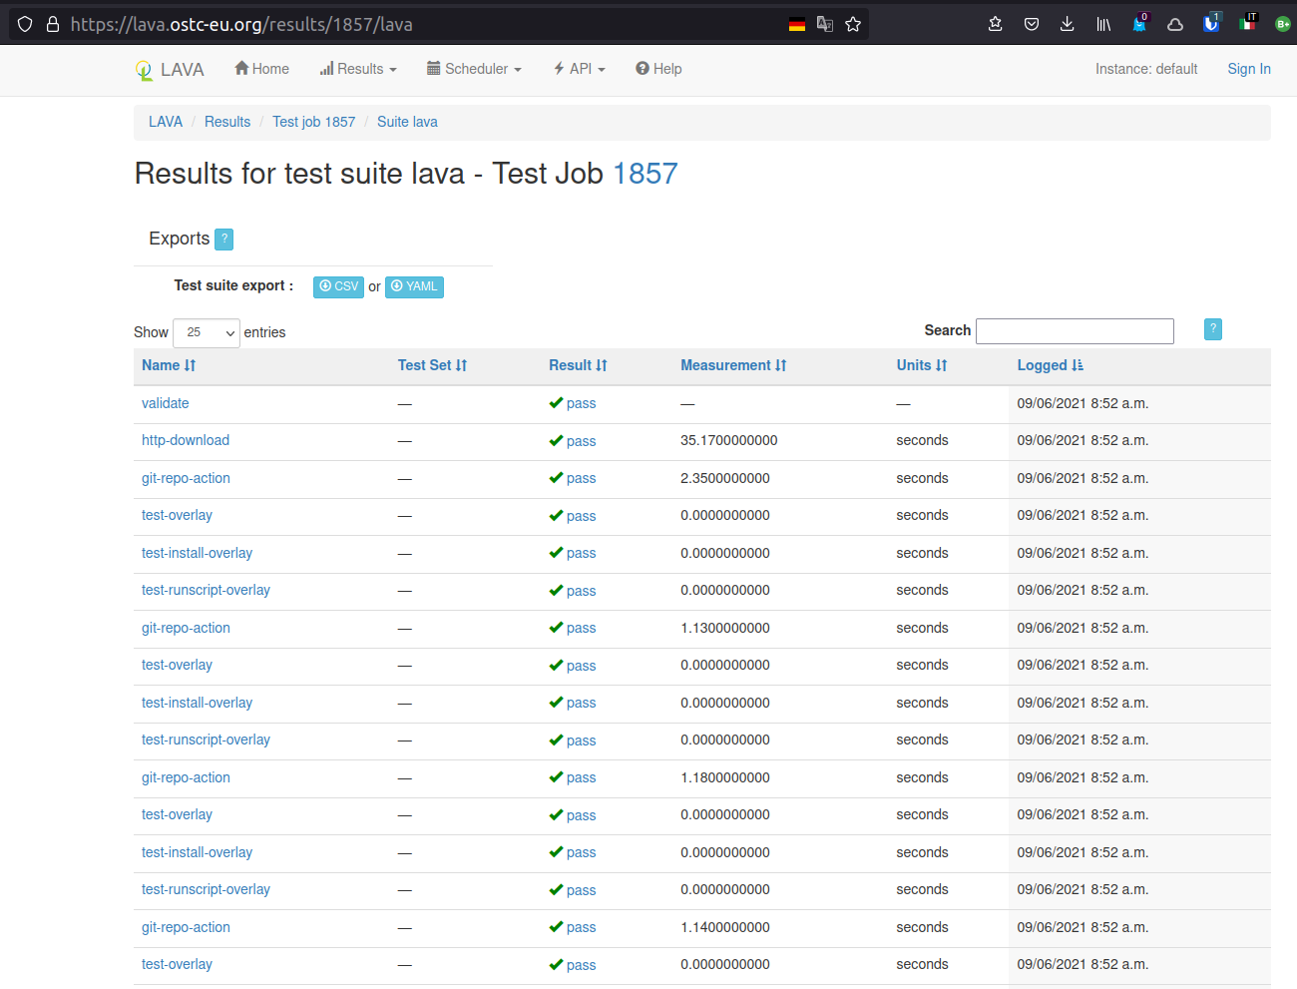
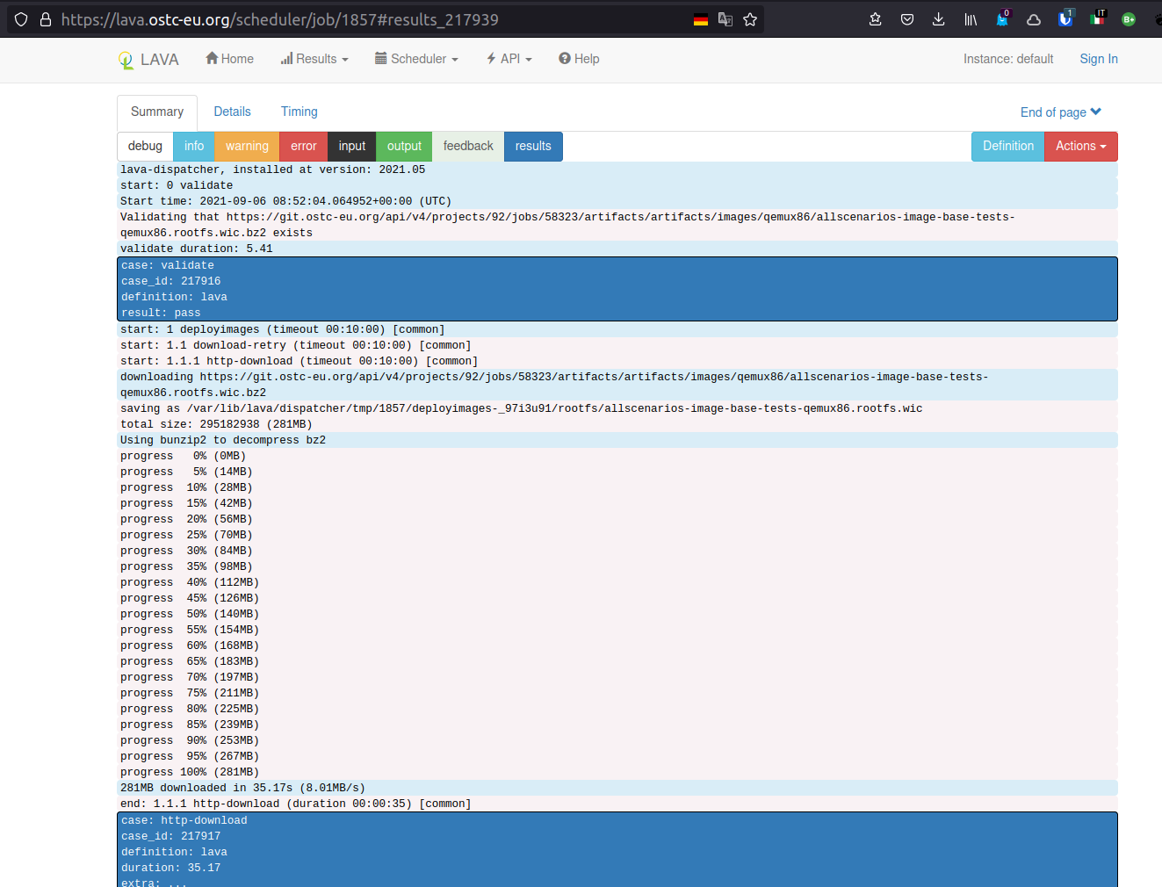
TESTING
LAVA based, decentralized, distributed device testing
Each member, contributor,... can add physical devices at different locations
Device added under testing can be shared via public cloud infrastructure
Each site can add one to hundreds of devices
Sites broadcast their availability to a central repository / directory
Building together a fully-connected all-scenario intelligent ecosystem
17

Slide 19
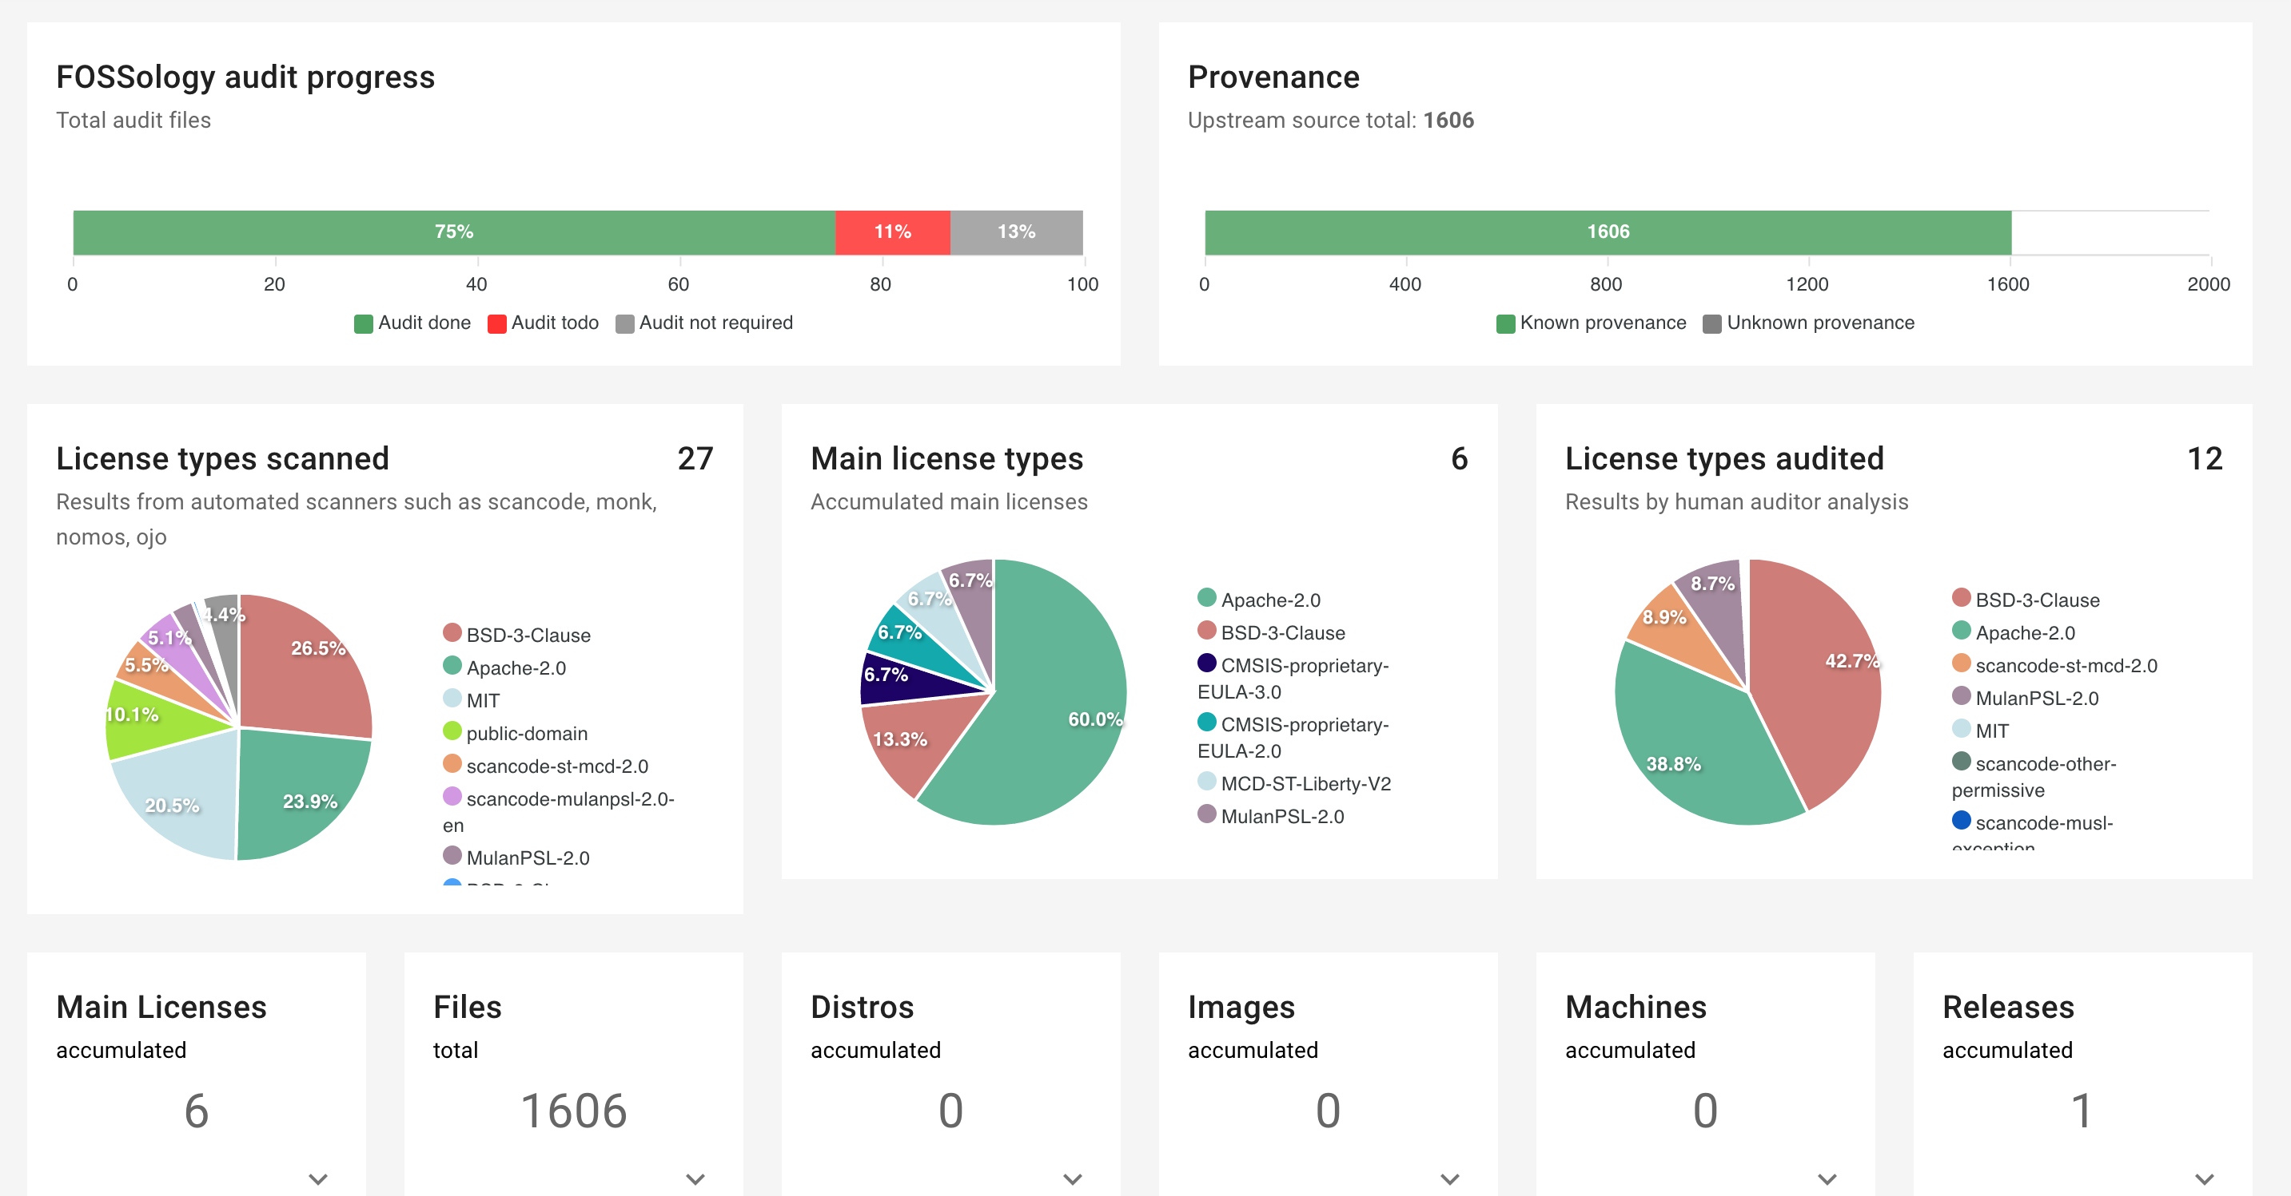
IP AND FOSS
Openchain Specification 2.0
Training, R&R, fundings, activity, IP auditing embedded into R&D
IP compliance integrated in CI / CD
Low Resolution SBOM
Merge --> Scan --> Fossology → Dashboard
High Resolution
Fossology --> IP Auditors --> SPDX
Releases SBOMs for alpha, beta and official yearly release
Building together a fully-connected all-scenario intelligent ecosystem
18

Slide 20


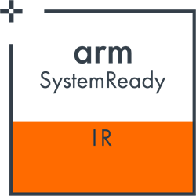
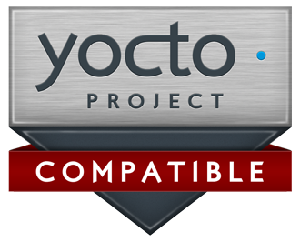


STANDARDS AND COMPLIANCE
Building together a fully-connected all-scenario intelligent ecosystem
19

Slide 21
BLUEPRINTS
Oniro Project integrates its various components into a representative use-case called a Blueprint.
A blueprint shows off the OS capabilities and best practices in building software-based products.
To this end, blueprints are a way to distill real-world products into a minimum viable product to demonstrate how partners and users may adopt Oniro Project securely in their own products.
What is a Blueprint?
It shows off a key feature or two of the product it is trying to emulate
It focuses on reproducing a representative user interaction for a use case
It is implemented on the closest appropriate reference HW platform from Oniro Project
Building together a fully-connected all-scenario intelligent ecosystem
20

Slide 22
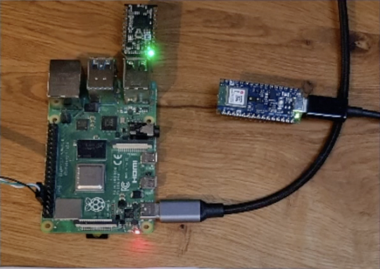
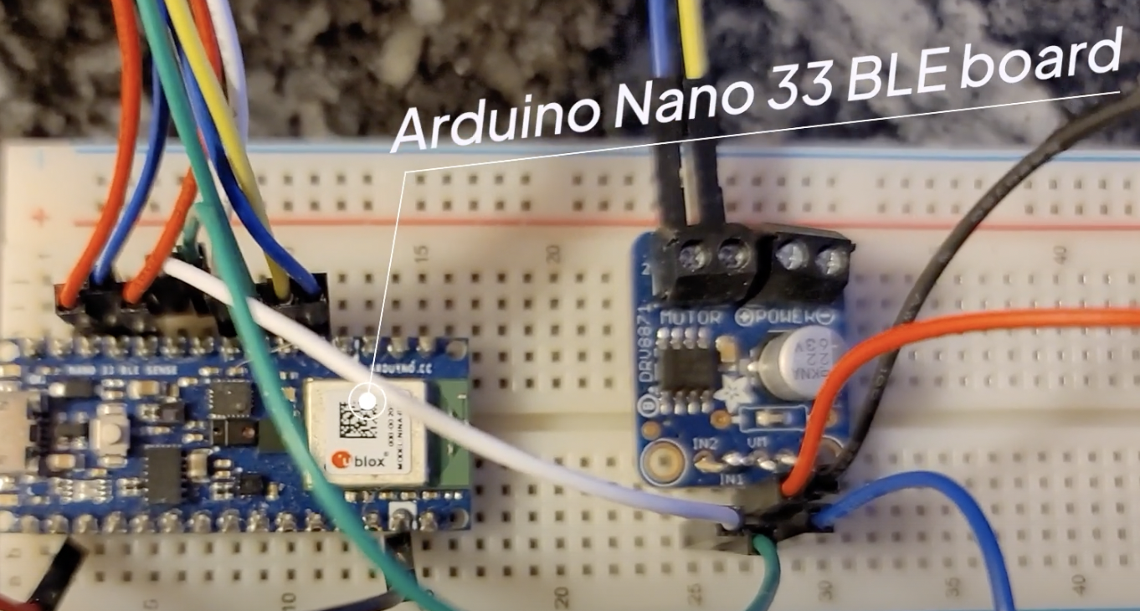
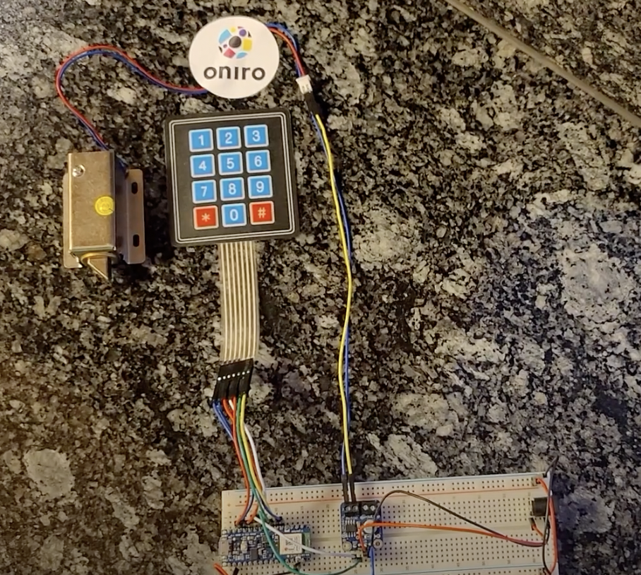
BLUEPRINTS
Doorlock Blueprint:
Operating several types of locks
Keypad input to operate the lock locally
Secure wireless communication to operate the lock locally
Secure communication with the lock remotely
Secure OTA
Gateway Blueprint:
WiFi AP functionality
OpenThread Border Router functionality
Onboarding of a mesh node in an OpenThread network
A mesh node to participate in an OpenThread network
Building together a fully-connected all-scenario intelligent ecosystem
21

Slide 23
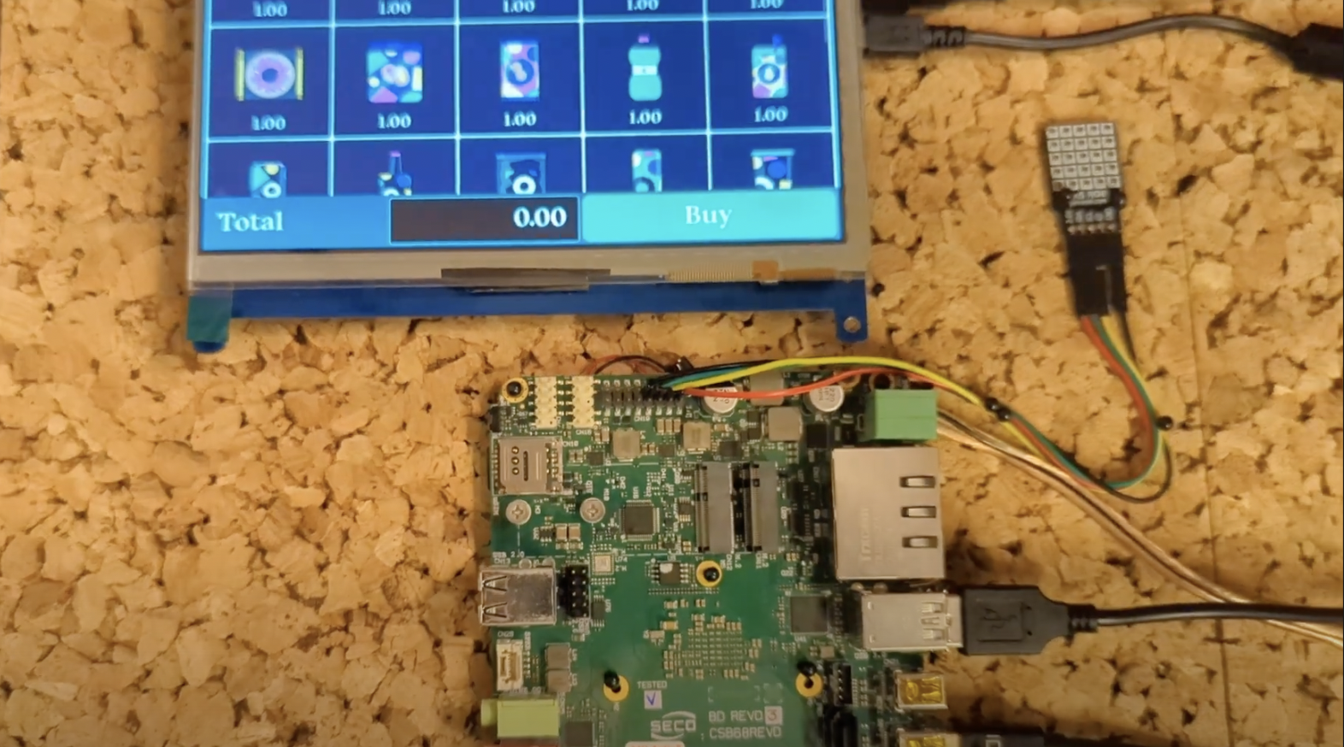
VENDING MACHINE BLUEPRINT
The Vending Machine Blueprint provides support for building a PoC smart vending machine with components showing the capabilities of the Oniro Project build infrastructure to easily build an end-to-end solution using multiple operating systems cooperating inside a product.
CHECK THE DOCUMENTION → https://docs.oniroproject.org/projects/blueprints/en/latest/vending-machine.html?highlight=vending%20machine
The Vending Machine blueprint provides full support for two complete setups. One based on Raspberry Pi 4B, an ARMv8 target, and one based on SECO B68, an X86 board
https://www.youtube.com/watch?v=HQ9hD63ypvI&list=PLy7t4z5SYNaQBDReZmeHAknEchYmu0LLa&index=10
Building together a fully-connected all-scenario intelligent ecosystem
22

Slide 24
VENDING MACHINE BLUEPRINT
DEMO TIME
Building together a fully-connected all-scenario intelligent ecosystem
23

Slide 25




WHAT’S IN IT FOR YOU?
CONSUMERS
DEVICE MAKERS
OEMs, SILICON VENDORS,
CHIPSET MANUFACTURERS
CONTENT CREATORS
If you are an end user, Oniro
integrates your various smart devices to
implement fast connection, capability col-
laboration, and resource sharing between
them. This way, your services can be seam-
lessly transferred to a suitable device that
delivers smooth all-scenario experience.
If you are a device developer, Oniro uses a component-based software de-
sign to tailor itself to your particular device
forms based on their respective resource
capabilities and service characteristics.
If you are an application developer, with
Oniro, you will have the choice
to focus on upper-layer service logic and
develop applications in a much easier and
more efficient way.
Building together a fully-connected all-scenario intelligent ecosystem
24

Slide 26


HOW TO GET STARTED
Download
Use
Read the
documentation
Contribute into
the community
Join our Mattermost Town Square chat
VISIT OUR WWW.ONIROPROJECT.ORG WEBPORTAL
Building together a fully-connected all-scenario intelligent ecosystem
26

Slide 27

Thank you!
Communication channels
Oniro Working Group mailing list: oniro-wg@eclipse.org
Oniro Projects (technical) mailing list: oniro-dev@eclipse.org
Chat channel: #oniroproject at libera.chat
Twitter: @oniro_project #Oniro

